Slide 1
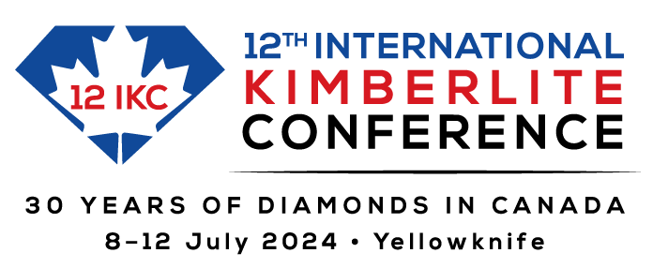
www.12ikc.ca
Notes:
2

Slide 2




www.12ikc.ca
International-kimberlite-conference
InternationalKimberliteConference
twitter.com/12_ikc
ikcacconference
Notes:
2

Slide 3
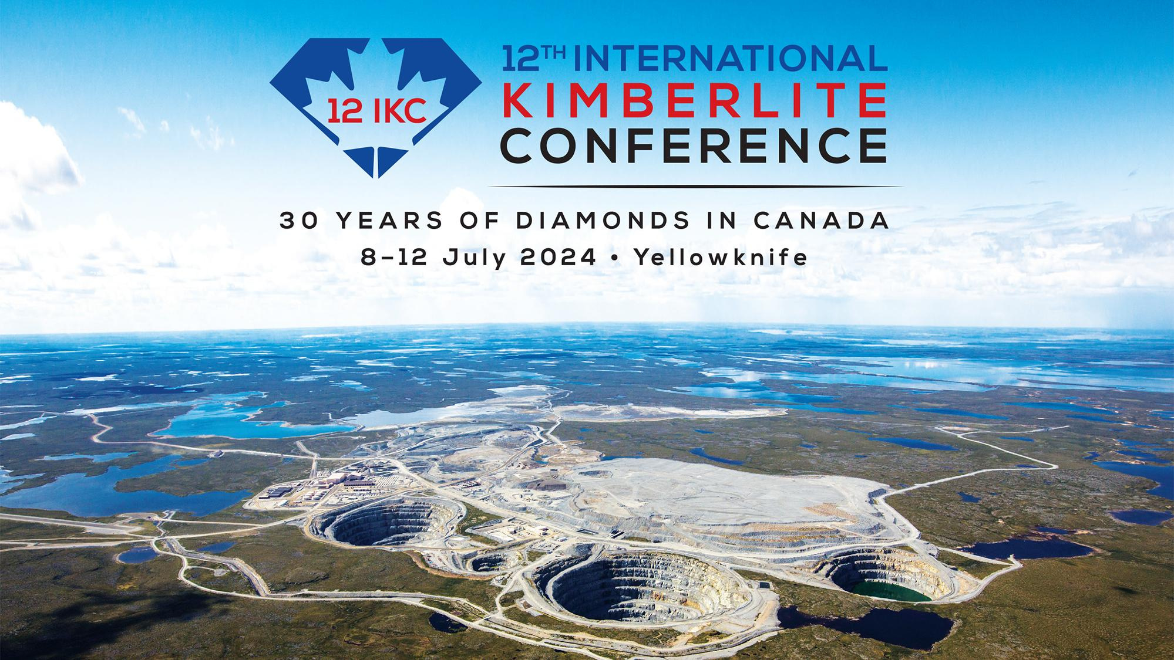
Ekati, Canada’s first diamond mine, Northwest Territories. Photo courtesy of Burgundy Diamond Mines

Slide 4

SCIENTIFIC THEMES
Diamonds
Emplacement and Economic Geology of Kimberlites and Related Magmas
The Origin and Evolution of Kimberlites and Related Magmas
Diamond Deposits – Exploration and Mining
Cratonic Mantle – Petrology, Geochemistry and Geophysics
FIELD TRIPS
Northwest Territories Diamond Mines
Kimberlites From Across Canada
Slave Craton Geology
Northwest Territories Kimberlite
Drill Core Collection
Advances in Drift Prospecting
for Kimberlite in Canada
SEMINARS
Invited speakers present a state-of-science summary covering emergent topics followed by moderated questions and extended discussion.
Kimberlitic Olivine: Tracking Mantle Cargo and Kimberlite Melt Evolution
Dr. Geoffrey Howarth
University of Cape Town, South Africa
Large Irregular Type II Diamonds: Genesis and Transport to Surface
Dr. Evan Smith
Gemological Institute of America
www.12ikc.ca
Notes:
4

Slide 5
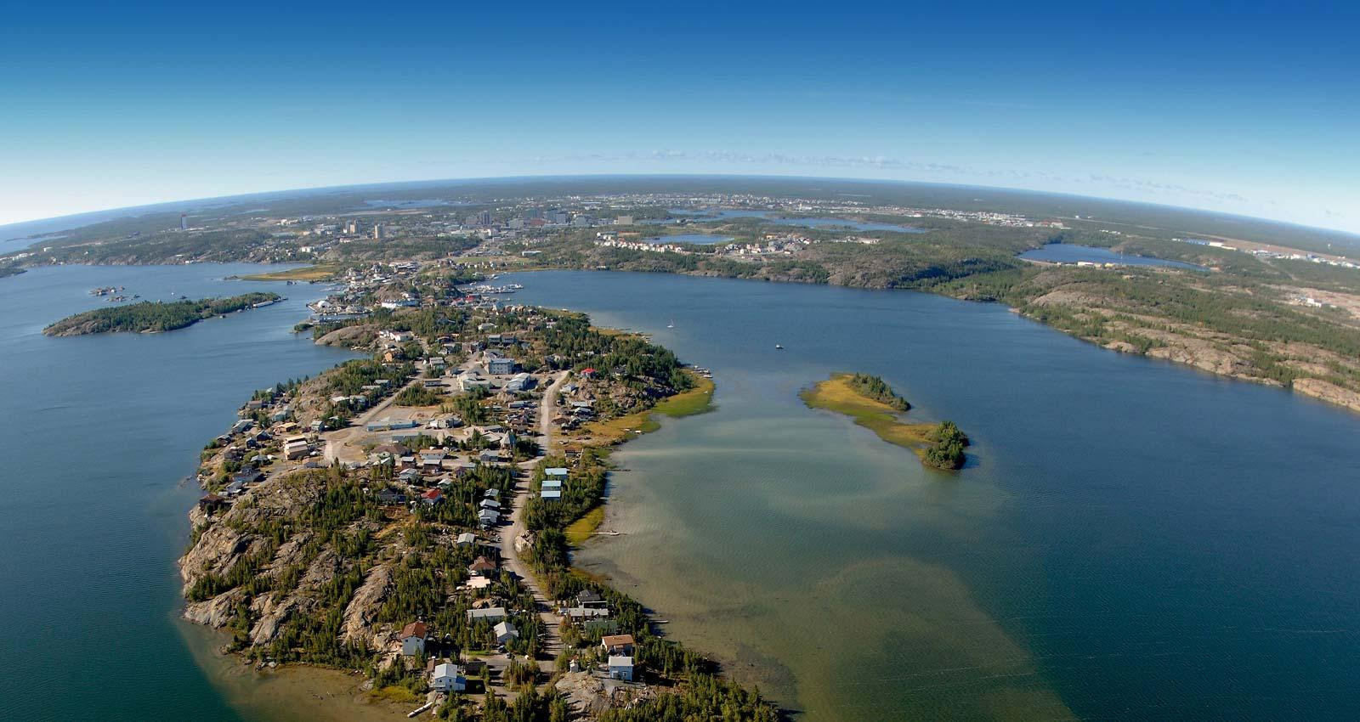
Yellowknife

Slide 6
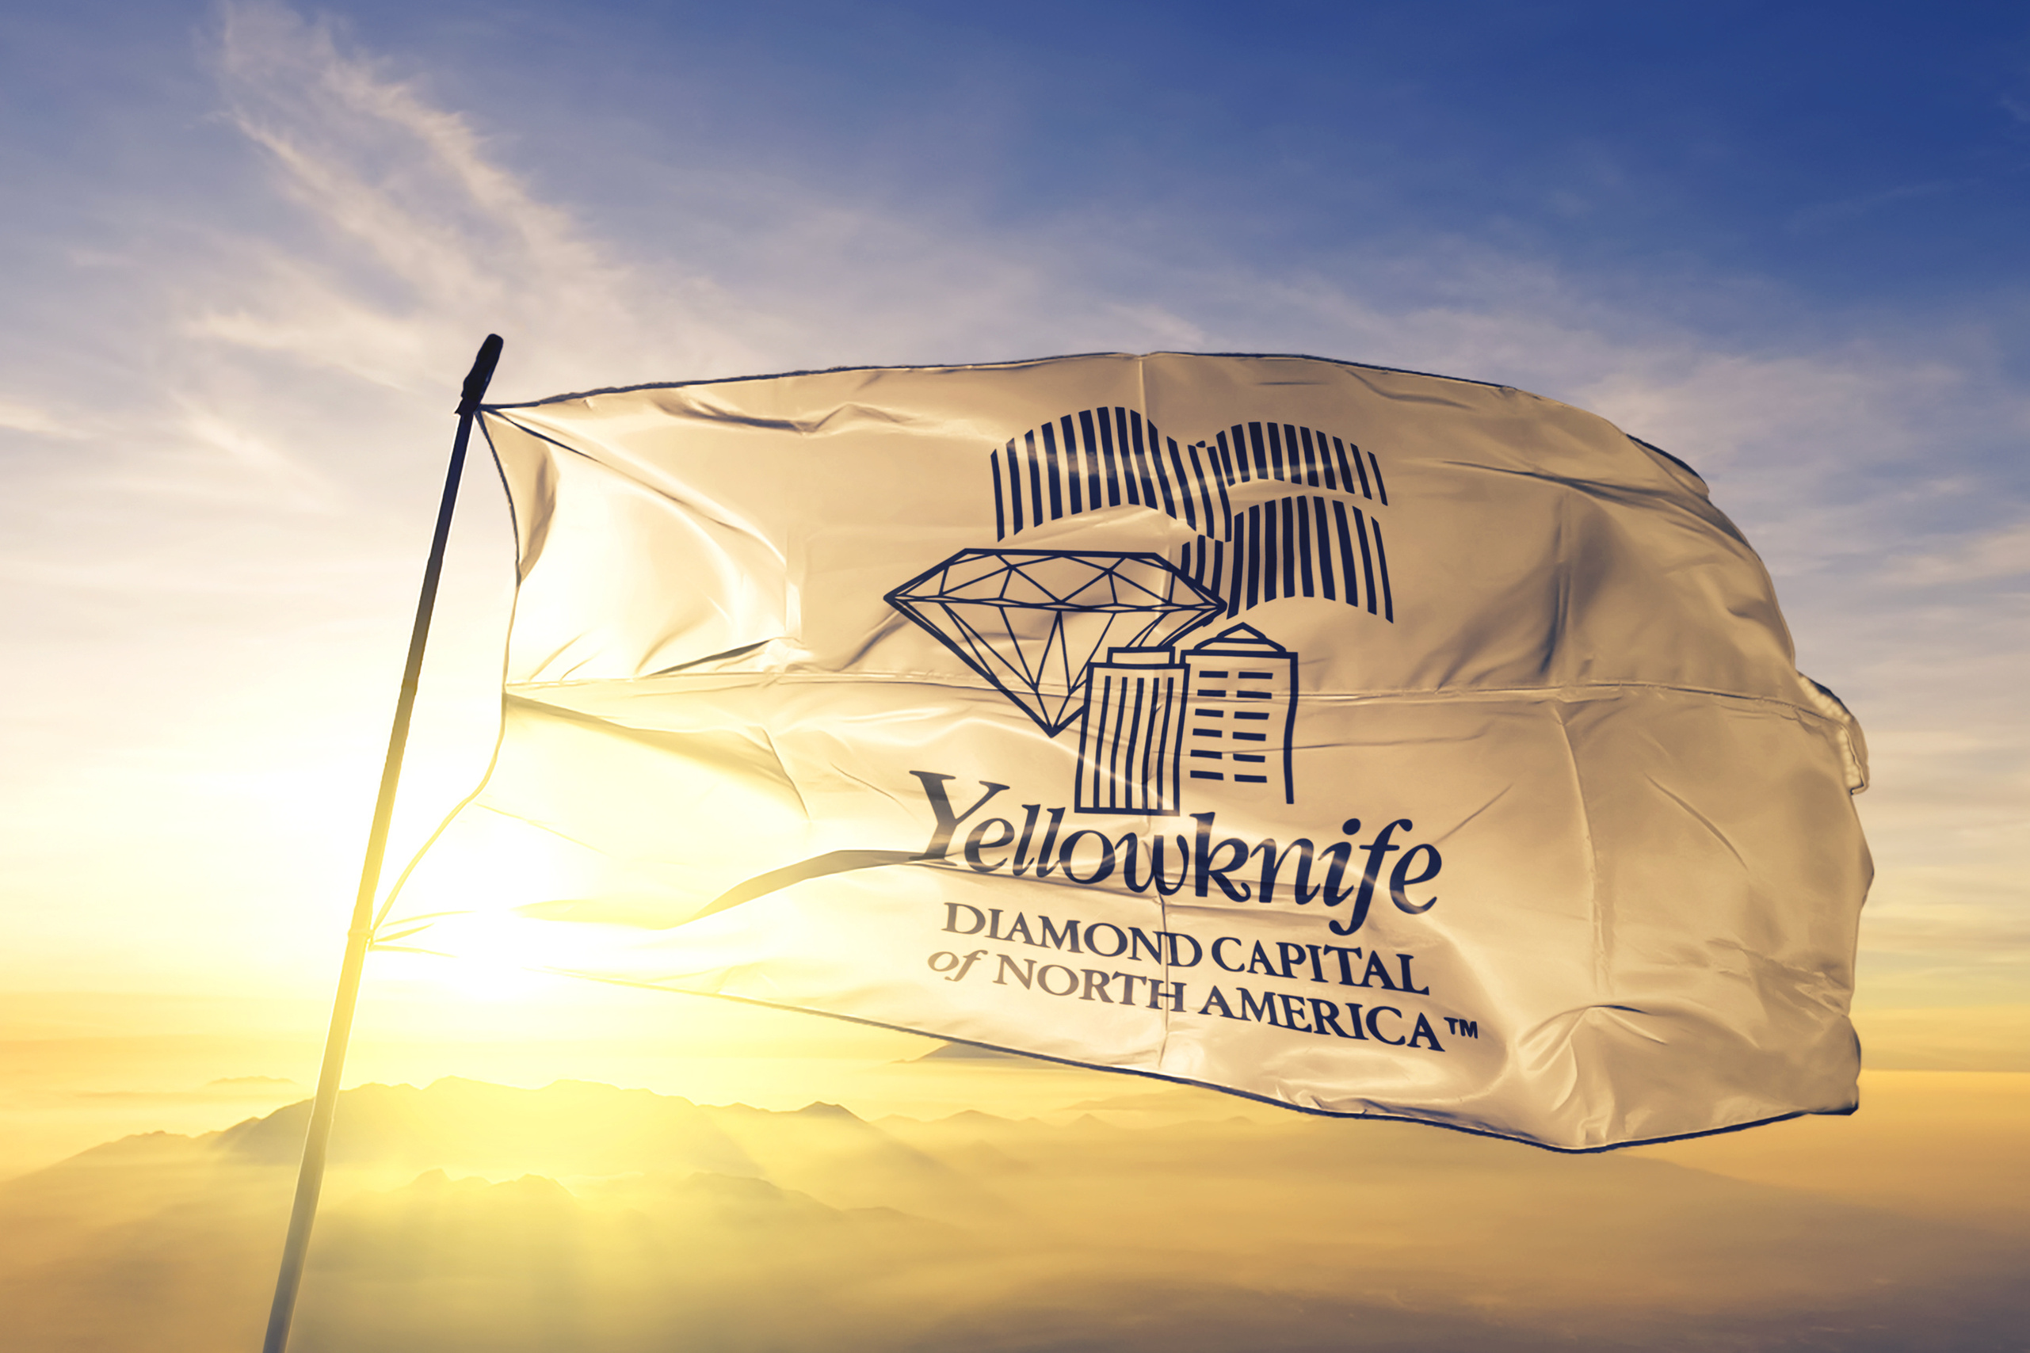


Slide 7
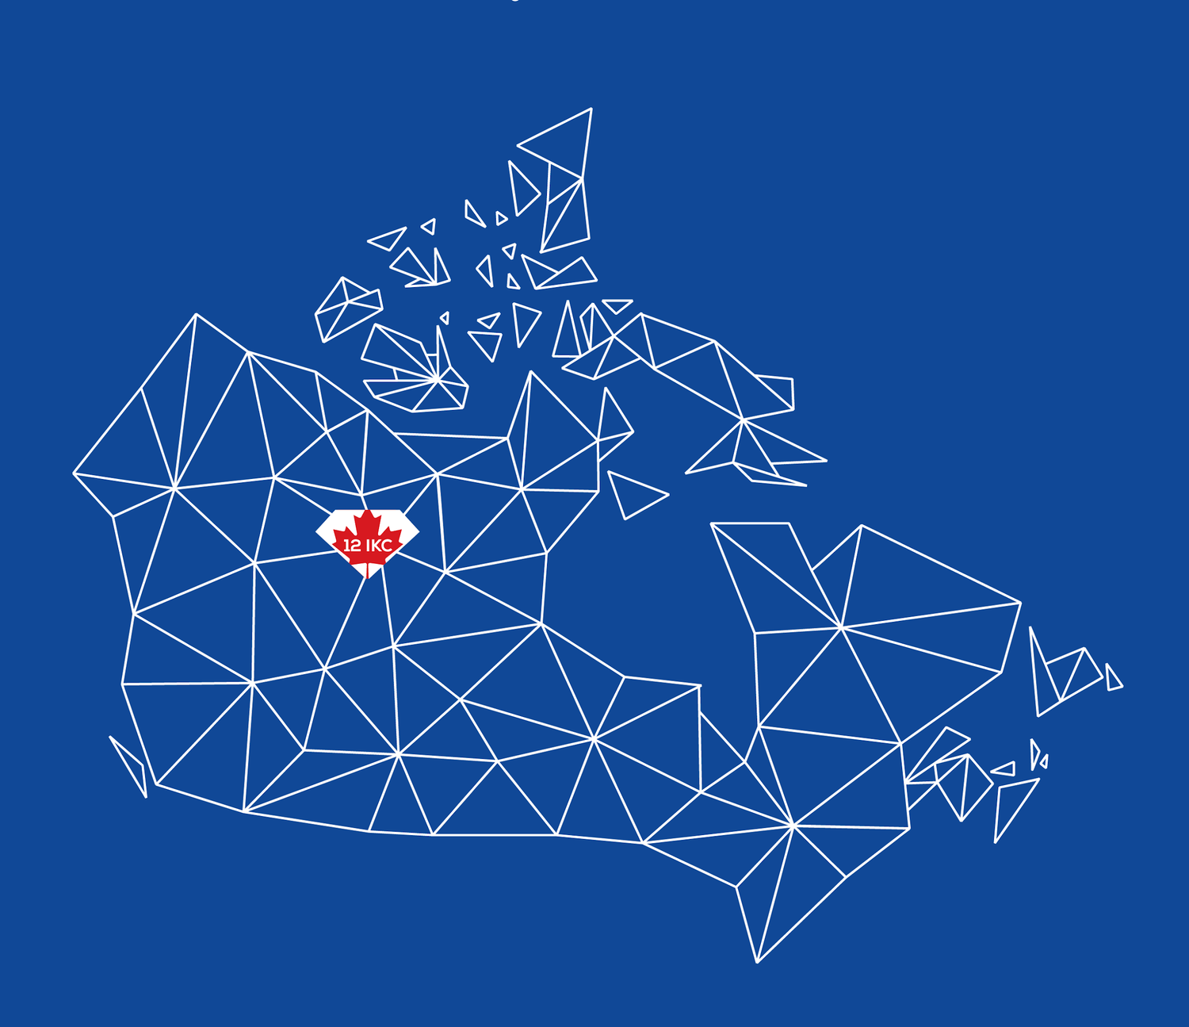
International-kimberlite-conference
InternationalKimberliteConference
twitter.com/12_ikc
ikcacconference
www.12ikc.ca

Slide 8

Meet Tindi,
a twin otter,
an essential necessity
in the Canadian North,
and
the 12 IKC Mascot!

